Slide 1


Technology, work and
the future of jobs
Presented by:
LACOUX Coline
DJEGHRI Amine
October 2018
1
Notes:
Hello, everyone. Thank you for having us. My name is __ and this is my partner ______,
and we're going to be speaking to you today about technology, jobs, and the future of work.

Slide 2
Summary
Introduction
Technology destroys jobs
Technology creates jobs
Conclusion
2
Notes:
Here is the summary of our presentation, we’re gonna first , start with an introduction, then talk about technology destroying /creating jobs ……

Slide 3
Introduction
3
Notes:
Let’s begin with the introduction

Slide 4


Introduction
Technology destroys jobs
Technology creates jobs
Conclusion
Battle between man and machine goes back centuries :
Are they taking our jobs?
Is my job safe?
Or :
Are they easing our workload?
4
Notes:
The battle between man and machines goes back centuries. Are they taking our jobs? Or are they merely easing our workload?
Is my job safe? It’s a question every employee has asked at some point, but at no time has it been more relevant than today. With current advancements in robotics and software, a lot are afraid that technology will erase their jobs.
Some believe that their jobs are untouchable – that automation only affects unskilled labor or factory workers. That is a gross miscalculation,

Slide 5
Introduction
Technology destroys jobs
Technology creates jobs
Conclusion
Before
Nowadays
100y ago: Vast majority of farmers
90 y ago: Million of jobs related to horse-drawn carriage
70y ago: 3% of the USA worked by the railroad industry
Only 2% are farmers (USA)
Those jobs are almost eliminated
0.1% of the workforce is involved in railroad industry
5
Notes:
hundred years ago, the vast majority of people in the world worked on farms.
Now, The invention and proliferation of technology has made it possible so
that a small minority of farmers (2% in America for exemple) can provide food for all.
-A little over one hundred years ago, there were millions of jobs related local transportation of the day: the horse-drawn carriage. All of those jobs building carriages,
manufacturing buggy whips, raising horses ect..
Again, progress and technology have all but eliminated those jobs, and here we are.
-Seventy years ago, a little over 3% of the U.S. workforce was employed by the railroad industry moving freight and
passengers around the country. Today, only 0.1% of the workforce is involved in the railroad industry,
yet it moves nearly three times the amount of freight around the country.

Slide 6
Introduction
Technology destroys jobs
Technology creates jobs
Conclusion
Will technology destroy all our jobs?
Will robots and IA replace humans?
6
Notes:
So , will technology destroy the jobs ??

Slide 7
Technology destroys jobs
7

Slide 8
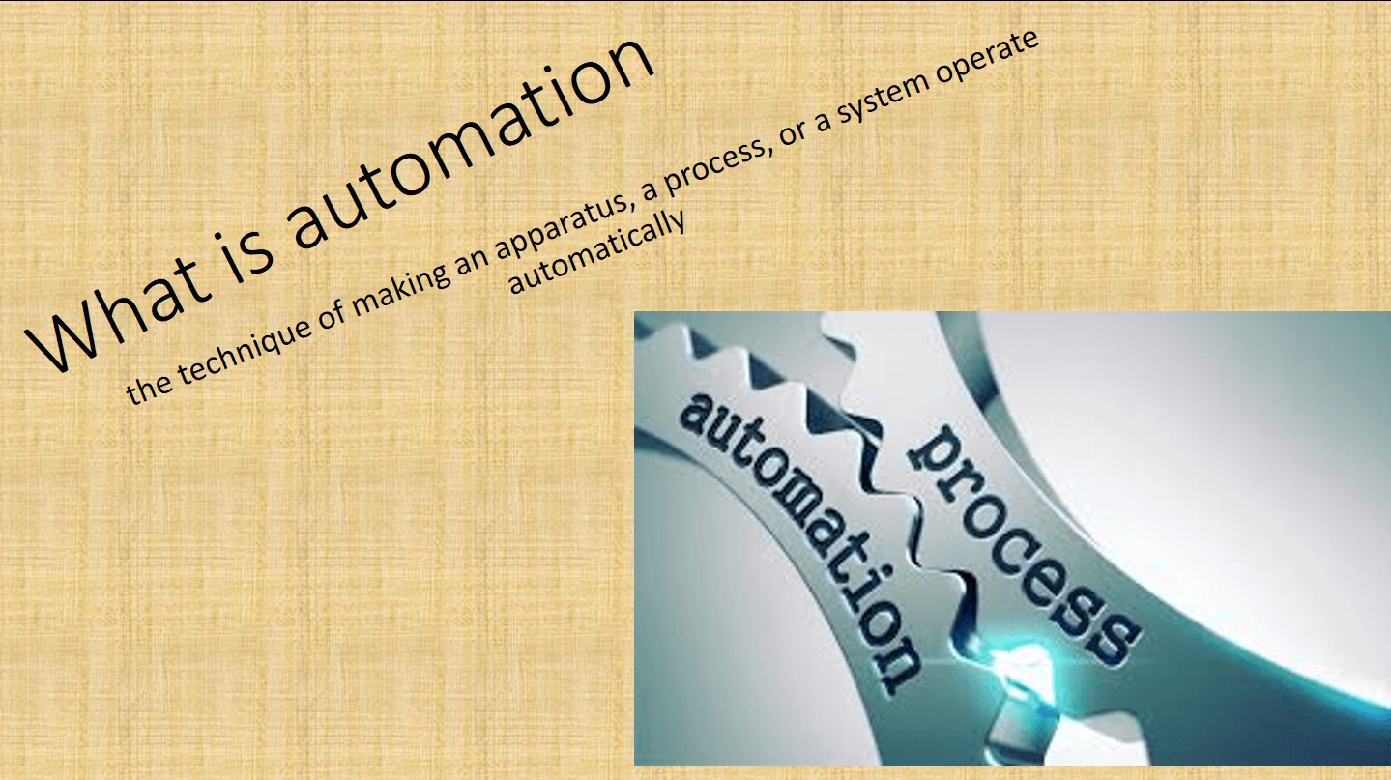
Introduction
Technology destroys jobs
Technology creates jobs
Conclusion
01
Automation & IA
02
Advantages
03
Disadvantages
8
Image source :
Notes:
So, job loss due to technology (automation and IA) has always threatened the workforce, and to understand better this of the automation & IA, let’s go back to their definitions
(Read definition)
It performs tasks that were previously performed by humans.
Automation is being used in a number of areas such as manufacturing, transport, utilities, defense, facilities, operations and lately, information technology.

Slide 9

Introduction
Technology destroys jobs
Technology creates jobs
Conclusion
01
Automation & IA
AI (artificial intelligence) is the simulation of human intelligence processes by machines
These processes include:
-learning
-reasoning
-self-correction
02
Advantages
03
Disadvantages
9

Slide 10
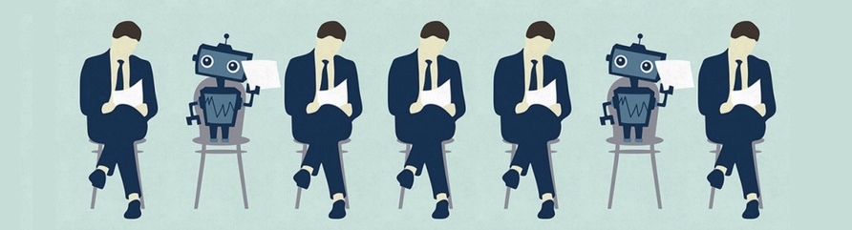
Introduction
Technology destroys jobs
Technology creates jobs
Conclusion
What is automation
Why are we using automation & IA ?
01
Substitute human muscle
Error Reduction
Higher productivity
Economic growth
02
Advantages
03
Disadvantages
10
Notes:
Technology directly substitutes human muscle power and, in so doing, raises productivity
the development of automation enabled by technologies including robotics and artificial intelligence brings the promise of higher productivity (and with productivity, economic growth
Many activities that workers carry out today have the potential to be automated, and many others have already been automated

Slide 11
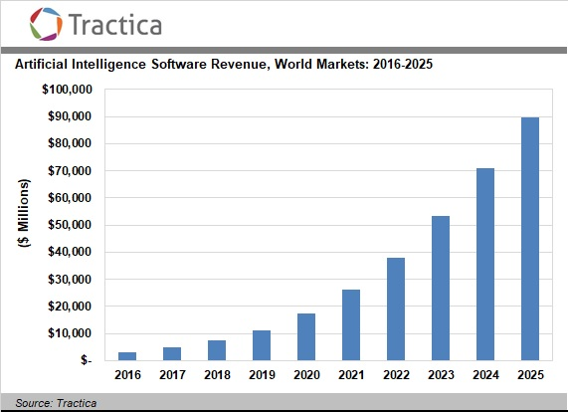
Introduction
Technology destroys jobs
Technology creates jobs
Conclusion
01
What is automation
02
Advantages
03
Disadvantages
11

Slide 12
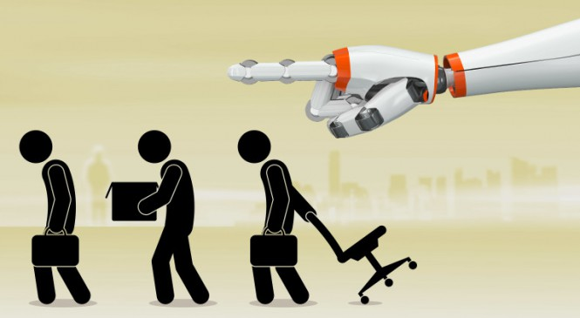
Introduction
Technology destroys jobs
Technology creates jobs
Conclusion
01
What is automation
Disadvantages automation & IA :
No creativity
High costs
02
Advantages
03
Disadvantages
Unemployment
12

Slide 13
Introduction
Technology destroys jobs
Technology creates jobs
Conclusion
Exemple : Agriculture
01
What is automation
02
Advantages
03
Disadvantages
13
Notes:
In the UK the first sector to feel this effect on any scale was agriculture
In 1871, 6.6% of the workforce of England and Wales were classified as agricultural labourers. Today that has fallen to 0.2%, a 95% decline in numbers.

Slide 14
Introduction
Technology destroys jobs
Technology creates jobs
Conclusion
What is automation
University of Oxford
Almost all jobs in the USA will be under pressure from automation
McKinsey Global Institute
800 million jobs could be lost to automation and IA
PricewaterhouseCoopers
30% of jobs in the UK 35% of jobs in Germany and 21% of jobs in Japan at risk of being replaced by machines in early 2030s
01
02
Advantages
03
Disadvantages
14

Slide 15
Introduction
Technology destroys jobs
Technology creates jobs
Conclusion
What is automation
Civil servant in the US
Mail career = the most endangered career
Newspaper reporter, flight attendant = disappearing
World Economic Forum (WEF) :
Over five million human jobs eliminated within the next four years across 15 of the world’s most powerful countries
01
02
Advantages
03
Disadvantages
15
Notes:
for exemple in the US:
In case you were thinking of pursuing a career as a civil servant, here’s one you should avoid: mail carrier. According to CareerCast, a national job search portal, it is the “most endangered” career
Your backup plan shouldn’t include newspaper reporter or flight attendant —those jobs are disappearing, too

Slide 16
Introduction
Technology destroys jobs
Technology creates jobs
Conclusion
Jobs already suffering :
Mail Career, New reporter, Factory Worker, Telemarketer, Bank Teller, Inventory and Warehouse Worker
Jobs at risk:
Cashier, Loan Officer, Insurance Rep, Accountant, Driver, Food services Worker, Journalist, Security Guard, Delivery Personnel, Postal Worker, Paralegal, Financial Analyst, Clerk
Jobs safe for now :
Social worker, Therapist, Doctor, Dentist, Police Officer, Teacher, Robotics Engineer, Software Engineer, Clergy
01
What is automation
02
Advantages
03
Disadvantages
16

Slide 17
Technology creates new jobs
17

Slide 18
Introduction
Technology destroys jobs
Technology creates jobs
Conclusion
01
New jobs
Replace some old jobs in industries
25% create in 25 years in US where type that didn’t exist before
New jobs : IT development, hardware manufacturing, app creation, IT systems management…
Technology = « Job creating machine »
02
Risen sectors
03
Other advantages
18
Notes:
Even while technologies replace some jobs, they are creating new work in industries that most of us cannot even imagine, and new ways to generate income. One-third of new jobs created in the United States in the past 25 years were types that did not exist, or barely existed, in areas including IT development, hardware manufacturing, app creation, and IT systems management.
Technology has boosted jobs in knowledge-intensive sectors

Slide 19
Introduction
Technology destroys jobs
Technology creates jobs
Conclusion
01
New jobs
‘Caring’ jobs have risen:
Care, education, provision of services to others
Raise of productivity and employment in knowledge-intensive sectors :
Medicine, education, professional services
02
Risen sectors
03
Stats
19
Notes:
‘Caring’ jobs have risen
The report cites a “profound shift”, with labour switching from its historic role, as a source of raw power, to the care, education and provision of services to others.
Technology has boosted jobs in knowledge-intensive sectors
In some sectors – including medicine, education and professional services – technology has raised productivity and employment

Slide 20
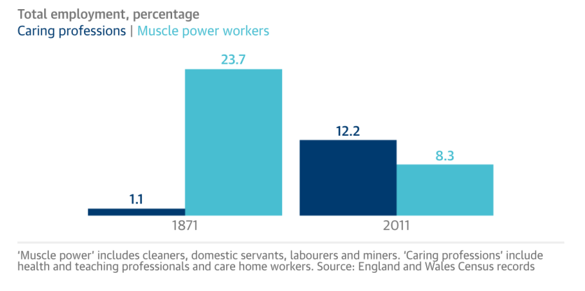
Introduction
Technology destroys jobs
Technology creates jobs
Conclusion
01
New jobs
02
Risen sectors
03
Stats
20
Notes:
So as we see, rather than destroying jobs, technology has been a “great job-creating machine”.

Slide 21
Introduction
Technology destroys jobs
Technology creates jobs
Conclusion
New jobs
Last decade :
580% increase in teaching and educational support assistants
183% increase in welfare, housing, youth and community workers
168% increase in care workers and home carers
01
02
Risen sectors
03
Stats
21
Notes:
So as we see, rather than destroying jobs, technology has been a “great job-creating machine”.

Slide 22
Introduction
Technology destroys jobs
Technology creates jobs
Conclusion
01
New jobs
Robots will transform, not replace, human work
02
Risen sectors
Automation (in US) :
Job lost: 22.7 million by 2025
Job created: 13.6 million
Job transformed: at least 25%
03
Stats
22
Notes:
. The net impact of new technologies on employment can be strongly positive.
Jobs lost: 22.7 million
Automation will displace 22.7 million US jobs by 2025. This equates to a job loss of 16% between 2015 and 2025.
Jobs created: 13.6 million
On the flip side, automation will create 13.6 million new jobs in the next decade. Automation will create jobs equivalent to 9% of the workforce in 2025. Those are new jobs that wouldn't exist otherwise. For every 10 jobs cannibalised by automation, one new job is created in software, engineering, design, maintenance, support, training or other work area
Jobs transformed: at least 25%
By 2019, automation will change every job category by at least 25%. Here's what we mean by transformation: A finance director in the 1960s spent a great deal of time doing arithmetic with simple calculators and paper ledgers to produce departmental budgets. When spreadsheets automated much of that task away, the job shifted to higher-order work l, such as financial strategy and investment.

Slide 23
Introduction
Technology destroys jobs
Technology creates jobs
Conclusion
01
New jobs
Technology has created more jobs than it has destroyed, according to 140 years of data
Other advantages:
Shifted consumption to more luxuries
Cut the prices of essentials : food, TVs, kitchen appliances
Price of cars halved in 25 years in the UK
02
Risen sectors
03
Stats
23
Notes:
Other advantages :
Technology has shifted consumption to more luxuries
Technological progress has cut the prices of essentials, such as food, and the price of bigger household items such as TVs and kitchen appliances. The real price of cars in the UK has halved in the last 25 years

Slide 24
Introduction
Technology destroys jobs
Technology creates jobs
Conclusion
Why robots will never fully replace humans ?
Robots Don’t Understand Irrational Thought
Robots Don’t Understand Context
Robots Don’t Understand Customer Service
Robots Lack Creative Problem Solving
People Prefer to Talk With A Human
26
Notes:
Robots Don’t Understand Irrational Thought
Robots Don’t Understand Context
Robots Don’t Understand Customer Service
Robots Lack Creative Problem Solving
People Prefer to Talk With A Human
Ajouter une phrase du genre : based on this, robots will not fully replace humans

Slide 25
Conclusion
24

Slide 26
Introduction
Technology destroys jobs
Technology creates jobs
Conclusion
Change is inevitable
Technology creates and transforms jobs more than it does destroy them.
Technology helps us in difficult jobs that need muscle power
25
Notes:
Final Word
Technology is changing whether we like it or not. Change is inevitable, but this has always been the case.

Slide 27
Thank you for your attention
27

Slide 28
Do you have any questions ?
28

Slide 29
Sources
https://www.theguardian.com/business/2015/aug/17/technology-created-more-jobs-than-destroyed-140-years-data-census
https://www.3ders.org/articles/20160118-3d-printing-and-fourth-industrial-revolution-to-eliminate-5-million-jobs-by-2020.html
https://www.theguardian.com/business/2015/nov/12/robots-threaten-low-paid-jobs-says-bank-of-england-chief-economist
http://fortune.com/2015/10/14/disappearing-jobs-america/
https://www.mckinsey.com/featured-insights/employment-and-growth/technology-jobs-and-the-future-of-work
https://www.technologyreview.com/s/538401/who-will-own-the-robots/
https://www.techopedia.com/definition/32099/automation
https://www.forbes.com/sites/quora/2018/01/18/technology-has-already-taken-over-90-of-the-jobs-humans-used-to-do/#4de262da1bdd
https://tech.co/robots-replace-humans-work-2017-08
https://www.moneycrashers.com/robots-automation-technology-replacing-jobs/
29

Slide 30
Sources
http://www.eng.ox.ac.uk/about/news/new-study-shows-nearly-half-of-us-jobs-at-risk-of-computerisation
https://www.mckinsey.com/featured-insights/future-of-work/jobs-lost-jobs-gained-what-the-future-of-work-will-mean-for-jobs-skills-and-wages
https://www.pwc.co.uk/economic-services/ukeo/pwcukeo-section-4-automation-march-2017-v2.pdf
https://content.wisestep.com/advantages-disadvantages-artificial-intelligence/
Images :
https://www.theguardian.com/business/2015/aug/17/technology-created-more-jobs-than-destroyed-140-years-data-census
https://www.forbes.com/sites/quora/2018/01/18/technology-has-already-taken-over-90-of-the-jobs-humans-used-to-do/#606278c71bdd
30

